Slide 1
Datacenter Migration Journey Overview
Kirill Kotlyarenko
Hoster Datacenter Migration Program Lead
Microsoft Corporation

Slide 2
Workshop agenda
Migration planning
Overview of Hoster DC Migration Program project - from start to finish
Purpose of migration plan
Identifying right customers
Identifying workloads for migration
Optimizing cloud costs with Reserved Instances and Azure Hybrid Benefit
Building v1 of the migration plan using a template
CSP Onboarding
CSP model and Partner Center overview
CSP discounts and rebates
Identity management in Partner Center
Customer support overview
CSP billing overview
Partner Center API integration
Azure IaaS
Azure Compute overview - VM families, regions, comparison with on-prem virtualization
Azure Storage overview - managed disks and storage accounts, planning storage performance
Azure Networking overview - basic and advanced network topologies in Azure, various connectivity options
Cost optimizations - working with Azure Reserved Instances and Azure Hybrid Benefit
Azure Database services
Azure SQL Database and Azure SQL Managed Instance overview
Cost optimizations - Azure Hybrid Benefit for SQL Server
Azure Database for MySQL and PostgreSQL overview
Migration technics
Backup & restore
VM lift & shift
Database migration
Migration assessment
Purpose of migration assessment
Assessment options: Cloudamize, Azure Migrate and Data Migration Assistant
Cloudamize deployment options
Building v2 of the migration plan by adding assessment details
Best practices and learnings
aka.ms/dcmkit

Slide 3
Datacenter migration journey
Sign Hoster DC Migration Program contract – DONE
Make a proposal for customers
Reach your customers
Identify workloads
Perform an assessment
Build and validate a migration plan
Move data.

Slide 4
What are customers looking to migrate to the cloud?
Virtual Machines
Databases
Data
Applications
Azure

Slide 5
Two options to consider
Reserved VM Instances (RIs)
Discounts up to 72% for 1 year or 3 year commitment for specific VM size in a region
Can be exchanged or returned if needed (12% fee for returns, up to $50K per customer)
Highly recommended for workloads, running 24/7
Azure Hybrid Benefit (AHB)
AHB for Windows Server – allows to leverage Windows Server licenses with active SA of the customer for Windows Server VMs
AHB for SQL Server – allows to leverage SQL Server licenses with active SA of the customer for Azure SQL Database

Slide 6
CSP Direct partners get:
For all services, expect RI:
15% discount on top of www.azure.com price
8% global consumption rebate
For RI:
5% discount and 10% rebate on top of www.azure.com RI price
Also there may be additional rebates, provided by local subsidiary.

Slide 7
Demo: Azure Calculator for CSP Partners

Slide 8
Right customers for migration
Customers that pay you annually
Customers that want more elasticity
Customers with own licenses for Windows Server and SQL Server
Enterprise customers with specific compliance requirements
Customers that are interested in geo-expansion
Customers that want to use rich public cloud service portfolio and go beyond IaaS

Slide 9
Right workloads
Workloads that can benefit from running not 24/7
Business-critical workloads, running 24/7
Windows-based workloads
SQL Server DBs
Heavy web apps
Stateless workloads, that can be containerized

Slide 10
Migration Plan v1
Build a list of participating customers
Build a list of workloads or assets that you wish to migrate
Write this down using migration plan template (link) and proceed to the assessment.

Slide 11
Azure in CSP model

Slide 12
Cloud Solution Provider (CSP) – innovative business model for Microsoft Partners.
Microsoft Azure
Sell Microsoft cloud services for business with your added value
Sell Integrated Offers and Services
Own and Control the Billing
Office 365
Dynamic 365
Own customer relationship
Provision Manage and Support
Enterprise Mobility Suite

Slide 13

Azure in CSP enables partners to…
Set the price, the terms and directly bill customers
Directly provision, own and manage Azure subscriptions
Be the first point of contact for customer support
1
2
3
4
Create cloud subscription + partner offer
Set package price and sell to customers
Place order for Microsoft Cloud Services
Offer single packaged solution

Slide 14
One program, two different business models
CSP Direct model (1-tier)
Partner works with Microsoft directly
Fixed discount for Azure
Partner needs to provide billing tools and build support practice
Credit check during the onboarding process
CSP Direct
CSP Indirect
Microsoft
Microsoft
CSP Indirect Provider
CSP Indirect model (2-tier)
2 partner tiers:
CSP Indirect Provider (aka Distributor) – transacts to Microsoft, provides billing tools and technical support.
CSP Indirect Reseller – sells Azure to customers through CSP Indirect Provider.
CSP Direct Partner
CSP Indirect Reseller
Customer
Customer

Slide 15
Partner Center Portal
partnercenter.microsoft.com
Core of partner’s CSP business. Manage Azure customers in one place.
Partner Center Key Capabilities
Easy to Use web portal
Provision Customers & Subscriptions
Admin-on-behalf-of customers
Office 365, EMS, Dynamics 365, Azure
Multi-channel & Multi-partner capabilities
Automated invoicing
Rich set of APIs for integration
CSP Content & Resources

Slide 16
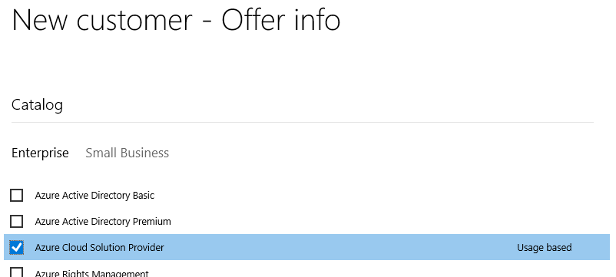
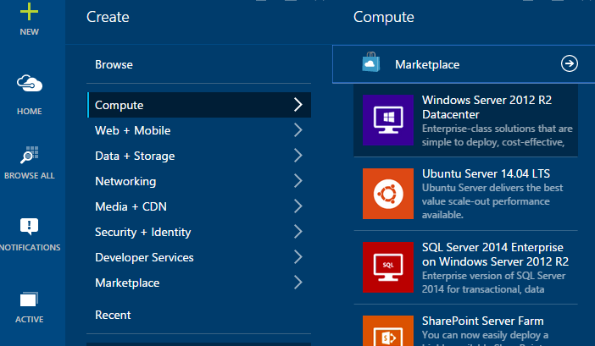
Selling Azure through CSP
Partner establishes customer relationship and “sells” Azure subscription
Services are created in the Azure Management portal
Usage occurs over the month
Microsoft bills the partner for the usage
Partner bills the customer for the usage
Microsoft Azure

Slide 17
Demo: Partner Center

Slide 18
Azure CSP Practices
What partners need to build to be successful in Azure CSP
1. Technical support practice
2. Billing practice
3. Deployment services practice
4. Cloud sales practice
CSP Direct partners get discount for Azure to implement it
CSP Indirect Reseller receives it from CSP Indirect Provider (Distributor)

Slide 19
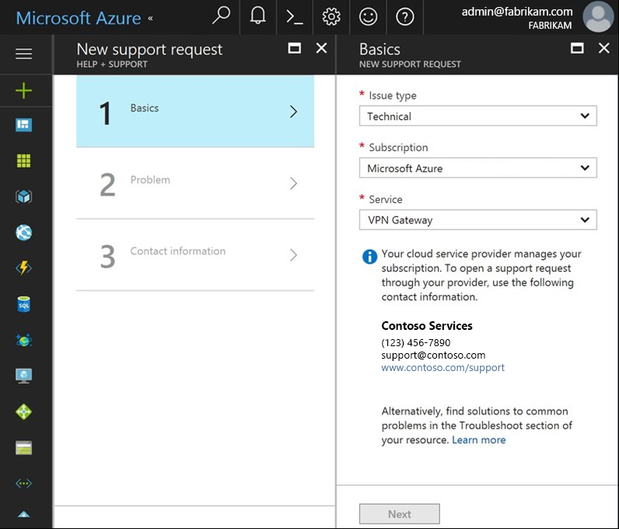
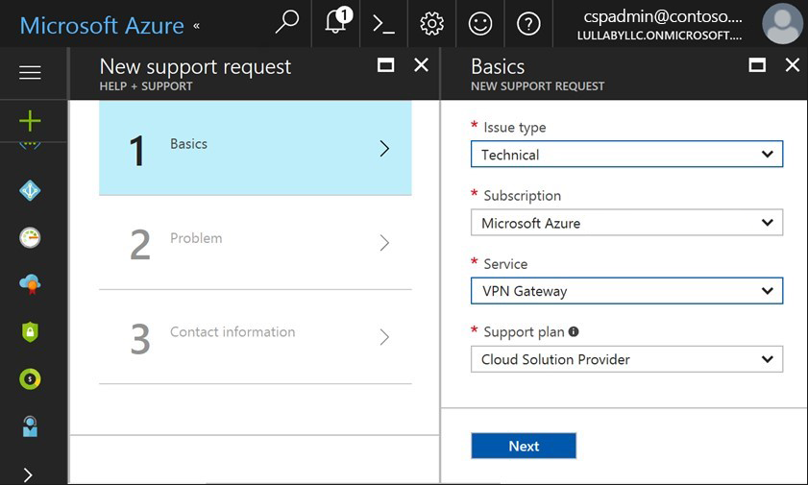
Microsoft doesn’t provide any support to CSP Customers.
Customer view
CSP Partner view

Slide 20
Technical support for Azure services
1
2
3
4
Register a new customer request in the own tracking system
1st tier of support:
Do basic troubleshooting
Check if there are any related service issues on Azure Resource Health
Provide solutions to the customer
2nd tier of support:
If problem is not resolved – escalate the request internally and do deep troubleshooting
Ensure that the environment is fully supported by Microsoft
Provide solutions or fix the problem in on behalf the customer
Escalate issues to Microsoft
Only after steps 1-3 (details)
Microsoft provides different support options for CSP Partners
All escalation requests are still managed by the partner.

Slide 21
Support options for CSP Partners
Advanced Support for Partners (ASfP)
Premier Support for Partners (PSfP)
Included with CSP
Submit Support Tickets On Behalf of End Customer | ✓ | ✓ | ✓
Support Account Management | No dedicated manager | Assigned from a regional pool | Designated support manager (TAM)
Technical break-fix | Through portal | Through portal + e-mail + phone | Through portal + e-mail + phone
Case Severity & Target Initial Response Times | Sev A: 2h Sev B: 4h Sev C: 8h | Sev A: 1h Sev B: 2h Sev C: 4h | Sev A: 1h Sev B: 2h Sev C: 4h
24x7 Critical Situation Support | -- | -- | ✓
Advisory “How To” Services | Requires MPN Silver/Gold competency | ✓ | ✓
Technical Presales Assistance | Requires MPN Silver/Gold competency | ✓ | ✓
CSP Integration Support | -- | Packaged | Customizable
Proactive Support Services | -- | Packaged | Customizable
 | Details | Details | Details

Slide 22
Pricing and billing of Azure services
Manage Azure pricing
Manage Azure billing
1
2
Set an end-customer price for Azure services
Provide guidance for pricing rules of different Azure services
Calculate the estimated monthly cost for customer workloads in Azure.
Define the billing rules between end-customer and CSP Partner
Provide consumption analysis capabilities to customers
Pay invoice from Microsoft (CSP Direct) or from Distributor (CSP Indirect) based on the consumption of all customers
Manage billing disputes and escalate billing issues to Partner Center support team.

Slide 23
Possible integrations
Integration with Partner Center – billing, customer provisioning
Partner Center REST API
Partner Center SDK
Integration on the Azure level – service deployment, policies, customer identity management etc.
Azure Resource Manager APIs
Azure GRAPH APIs
More details: link

Slide 24
Azure IaaS

Slide 25
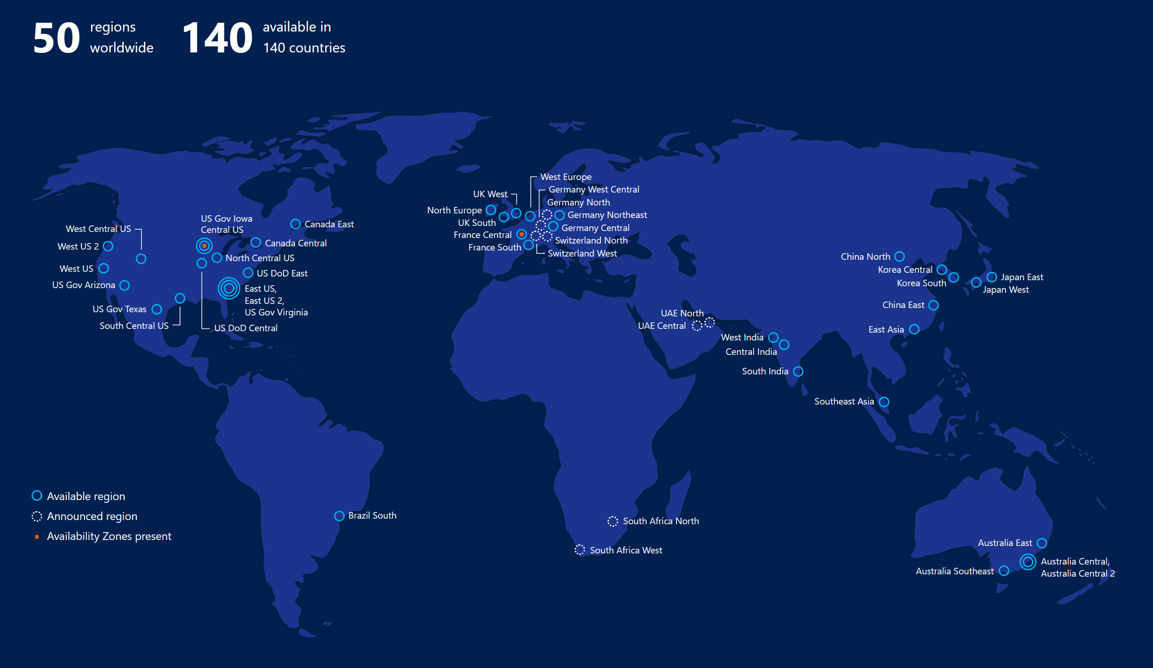

Slide 26
Core components of Azure IaaS
Compute
Storage
Networking
Management
Virtual machines
Availability sets
VM Scale Sets
Etc.
Disks (Standard, premium)
Blob storage (Hot, cool)
Files
Etc.
Virtual networks
VPN, ExpressRoute
Load Balancer
DNS, Traffic Manager
Etc.
Azure Resource Manager (ARM)
Azure Active Directory
Portal
KeyVault etc.

Slide 27

Virtual Machines
Ubuntu, Red Hat, Windows, SUSE, CoreOS
Quick resize through reboot
Local temp storage (HDD or SSD)
Azure Storage for OS and data disks
Hundreds of items in marketplace
Notes:
Really the basic building block of all other compute services
Valuable for cases where you’re simply lifting-and-shifting an existing workload to the cloud and want to maintain the existing topology.
Huge variety of OS images available, including all the popular Linux distros
Support for many popular configuration tools, including Chef and Puppet.
Available in many different sizes to fit your workload, including the recently announced N-series which offer Nvidia GPUs for graphically intense workloads.
And of course, since VMs make up the basic building blocks in our Compute story, many people have built interesting things out of them, which are available in the marketplace…

Slide 28

Compute options for all types of apps
Entry level
Burstable
General Purpose
Compute Intensive
Storage Optimized
A
Av2
B
D
Dv2
Dv3
F
Fv2
L
High Performance Computing
Memory Optimized
Graphics Intensive
Purpose-built SAP HANA
G
Ev3
M
NC
NCv2
NV
ND
H
HANA
NCv3
NVv2
NDv2
(coming soon)
(coming soon)
Notes:
Key Messages: This slide simply sets the stage. Azure compute offers a rich development environment and IaaS capabilities that can help you develop a broad range of applications. For each type of application you can select the right VM that best suits your needs. We continue to expand and enrich the variety of VMs available to you so you can continue to fuel your innovation and growth to Azure.
Products recently introduced include:
1. M-Series VMs now certified for SAP HANA. You can now develop applications on Azure for the SAP HANA platform that has been recently certified for M-Series. The M-series family of Azure virtual machines are the largest memory-optimized VMs to date. These VMs are ideal for heavy in-memory workloads such as SAP HANA. With the M-Series, these databases can load large datasets into memory and utilize the fast memory access with huge amounts of vCPU parallel processing to speed up queries and enable real-time analytics. You can deploy these large workloads in minutes and on-demand, scaling elastically as your usage demands. Refer to the blog for the announcement https://azure.microsoft.com/en-us/blog/azure-m-series-vms-are-now-sap-hana-certified/
2. NVIDIA’s latest GPU for HPC and AI is available in Azure. For those of you focused on HPC applications and AI, not too long ago we announced major expansion of our GPU fleet. NVIDIA GPUs are at the heart of a lot of discovery and innovation. And with our tools like Batch, Batch AI, and the Data Science Virtual Machine images, Azure customers and developers are in a great position to expand what is possible and bring to market innovative AI and HPC applications.https://azure.microsoft.com/en-us/blog/ncv3-vms-generally-available-other-gpus-expanding-regions/ NCv3 brings NVIDIA’s latest GPU – the Tesla V100 – to our best-in-class HPC, machine learning, and AI products to bring huge amounts of value across a variety of industries. One preview customer told us their speech recognition models trained in less than 20 minutes, instead of the 1-2 hours that previous generation GPUs required. Another customer told us about the 40-50% performance boost they saw on their reservoir simulations. The ND-series, powered by NVIDIA Tesla P40 GPUs based on the new Pascal Architecture, will be excellent for training and inference. These instances will provide more than twice the performance over the previous generation for AI workloads utilizing CNTK, TensorFlow, Caffe, and other frameworks. The ND-series also offer a much larger GPU memory size (24 gigabytes), enabling you to fit much larger neural net models. Also, like our NC-series, the ND-series will offer RDMA and InfiniBand connectivity, so you will be able to run large-scale training jobs spanning hundreds of GPUs.
3. We have also announced two new VM sizes, E64i_v3 and E64is_v3, which are isolated to hardware and dedicated to a single customer. These VMs are best suited for workloads that require a high degree of isolation from other customers for compliance and regulatory requirements. You can also choose to further subdivide the resources by using Azure’s support for nested VMs. The E64i_v3 and E64is_v3 will have the exact same performance and price as their cousins E64_v3 and E64s_v3 and will be available in each of the regions where E64_v3 and E64s_v3 are available today. The small letter ‘i’ in the VM name denotes that they are “Isolated” sizes. Unlike the E64_v3 and E64s_v3, the two new E64i_v3 and E64is_v3 sizes are hardware bound sizes. They will live and operate on our Intel® Xeon® Processor E5-2673 v4 2.3GHz hardware only and will be available until at least December 2021. We will provide reminders 12 months in advance of the official decommissioning of the sizes and offer an updated isolated size like these sizes on our next hardware version. These two new E64i_v3 and E64is_v3 sizes will be available in the on-demand portal. Starting on May 1st, 2018, they will also be made available for purchase as 1-year Reserved VM Instances.
The E64i_v3 and E64is_v3 are joining our other Isolated VM sizes in the Azure family:
Standard_D15_v2
Standard_DS15_v2
Standard_E64i_v3
Standard_E64is_v3
Standard_F72s
Standard_G5
Standard_GS5
Standard_L32s
Standard_M128ms
Standard_M128s
We encourage you to use these VMs for workloads needing a high degree of isolation.
----------------------------------------
BACKGROUND INFO
Entry Level
A-series VMs have CPU performance and memory configurations best suited for entry-level workloads like development and test. They are economical and provide a low-cost option to get started with Azure.
Example use cases include development and test servers, low-traffic web servers, small-to-medium databases, servers for proof-of-concepts, and code repositories.
Burstable
B-series are economical virtual machines that provide a low-cost option for workloads that typically run at a low-to-moderate baseline CPU utilization, but sometimes need to burst to significantly higher CPU utilization when the demand rises.
Example use cases include development and test servers, low-traffic web servers, small databases, micro services, servers for proof-of-concepts, and build servers.
General Purpose
The Dv3 and Ev3 sizes are able to run Windows 2016 hosts and enable Nested Virtualization and Hyper-V Containers for these new VM sizes. Nested virtualization allows you to run a Hyper-V server on an Azure virtual machine. With nested virtualization, you can run a Hyper-V Container in a virtualized container host, set up a Hyper-V lab in a virtualized environment, or to test multi-machine scenarios. You can find more information on Nested Virtualization on Azure.
Our new Dv3 VM sizes are a good balance of memory to vCPU performance, with up to 64 vCPUs and 256 GiB of RAM. Our newly named Ev3 sizes provide you with more memory to vCPU than the Dv3, so you can run larger workloads on sizes up to our largest E64 size, with 64 vCPUs and 432 GiB of RAM. D2v3 instances are the latest hyper-threaded generation of general purpose instances.
Compute Intensive
The F-series VM sizes sport a higher CPU-to-memory ratio. They feature 2 GB RAM and 16 GB of local Solid State Drive (SSD) per CPU core, and are optimized for compute-intensive workloads. The F-series is based on the 2.4 GHz Intel Xeon E5-2673 v3 (Haswell) processor, which can achieve clock speeds as high as 3.1 GHz with the Intel Turbo Boost Technology 2.0. Example use cases include scenarios like batch processing, web servers, analytics, and gaming.
Azure now offers the fastest Intel Xeon Scalable processor, code-named Skylake, in the public cloud. In Azure, we have seen growing demand for massive large-scale computation by customers doing financial modeling, scientific analysis, genomics, geothermal visualization, and deep learning. Our drive to continuously innovate in Azure allows us to offer cost-effective and best-in-class hardware for these world-changing workloads.
Memory Optimized
The M-series family of Azure virtual machines are the largest memory optimized VMs to date. These VMs are ideal for heavy in-memory workloads, such as SAP HANA. With the M-series, these databases can load large datasets into memory and utilize the fast memory access with huge amounts of vCPU parallel processing to speed up queries and enable real-time analytics. You can deploy these large workloads in minutes and on-demand, scaling elastically as your usage demands.
G-series VMs feature the latest Intel Xeon processor E5 v3 family, two times more memory, and four times more Solid State Drive storage (SSDs) than the General Purpose D-series. G-series sport RAM of up to ½ TB and 32 CPU cores, and provide unparalleled computational performance, memory, and local SSD storage for your most demanding applications. Example use cases include large SQL and NoSQL databases, ERP, SAP, and data warehousing solutions.
Optimized for in-memory hyper-threaded applications, the E-series family of Azure virtual machines are optimized for heavy in-memory applications such as SAP HANA. These VMs are set up with high memory-to-core ratios that make them well-suited for relational database servers, with medium-to-large caches, and in-memory analytics. The E-series VMs range from 2 to 64 vCPUs and 16 to 432 GiB RAM, respectively.
Two new VM sizes, E64i_v3 and E64is_v3, which are isolated to hardware and dedicated to a single customer. These VMs are best suited for workloads that require a high degree of isolation from other customers for compliance and regulatory requirements. The E64i_v3 and E64is_v3 will have the exact same performance and price as their cousins E64_v3 and E64s_v3, and they will be available in each of the regions where E64_v3 and E64s_v3 are available today. The small letter “I” in the VM name denotes that they are “Isolated” sizes.
Graphics Intensive
NCv3 is available in East and South Central regions in the US. NCv3 brings NVIDIA’s latest GPU – the Tesla V100 – to our best-in-class HPC, machine learning, and AI products to bring huge amounts of value across a variety of industries. One preview customer told us their speech recognition models trained in less than 20 minutes, instead of the 1-2 hours that previous generation GPUs required. Another customer told us about the 40-50% performance boost they saw on their reservoir simulations.
The ND-series, powered by NVIDIA Tesla P40 GPUs based on the new Pascal Architecture, will be excellent for training and inference. These instances will provide more than twice the performance over the previous generation for FP32 (single-precision floating-point operations), for AI workloads utilizing CNTK, TensorFlow, Caffe, and other frameworks. The ND-series also offer a much larger GPU memory size (24 gigabytes), enabling you to fit much larger neural net models. Also, like our NC-series, the ND-series will offer RDMA and InfiniBand connectivity, so you will be able to run large-scale training jobs spanning hundreds of GPUs. They are available in East and West US and Southeast Asia.
HPC
H-series VM sizes are suitable for any compute-intensive workload like complex engineering and scientific workloads like computational fluid dynamics, crash simulations, seismic exploration, and weather forecasting simulations. H-series VMs come with the fastest CPUs in public cloud, as well as RDMA with InfiniBand, which allows you to run high-performance computing (HPC) apps. The H-series is available across multiple regions in the US, Europe, and Asia.
Azure offers a comprehensive set of compute options for all types of apps, including entry-level, general purpose, memory optimized, storage optimized, and compute intensive.
Our HPC and GPU fleet has fast performance with built-in Infiband support. Let’s take a look at some of the new compute types we’ve added:
H-series: InfiniBand networking (industry-leading)
SAP Large Instances up to to 20 TB (industry-leading)
Fast networking (FPGA) – up to 30 gb/s from 25 gb/s last year (industry-leading)

Slide 29
.. From entry-level to storage optimized …
Intel Haswell E5-2673 v3
Lowest cost, flexible CPUs
Up to 8vCPUs, 32GiB RAM
Intel® Xeon® Platinum 8168 processor (Skylake)
Entry level
Burstable
General Purpose
Compute Intensive
Storage Optimized
A
Av2
B
D
Dv2
Dv3
F
Fv2
L
Intel Broadwell E5-2673 v4
Hyper-Threaded CPUs
Up to 64 vCPU’s, 256GB RAM
Notes:
Entry Level
A-series VMs have CPU performance and memory configurations best suited for entry-level workloads like development and test. They are economical and provide a low-cost option to get started with Azure.
Example use cases include development and test servers, low-traffic web servers, small-to-medium databases, servers for proof-of-concepts, and code repositories.
Burstable
B-series are economical virtual machines that provide a low-cost option for workloads that typically run at a low-to-moderate baseline CPU utilization, but sometimes need to burst to significantly higher CPU utilization when the demand rises.
Example use cases include development and test servers, low-traffic web servers, small databases, micro services, servers for proof-of-concepts, and build servers.
General Purpose
The Dv3 and Ev3 sizes are able to run Windows 2016 hosts and enable Nested Virtualization and Hyper-V Containers for these new VM sizes. Nested virtualization allows you to run a Hyper-V server on an Azure virtual machine. With nested virtualization, you can run a Hyper-V Container in a virtualized container host, set up a Hyper-V lab in a virtualized environment, or to test multi-machine scenarios. You can find more information on Nested Virtualization on Azure.
Our new Dv3 VM sizes are a good balance of memory to vCPU performance, with up to 64 vCPUs and 256 GiB of RAM. Our newly named Ev3 sizes provide you with more memory to vCPU than the Dv3, so you can run larger workloads on sizes up to our largest E64 size, with 64 vCPUs and 432 GiB of RAM. D2v3 instances are the latest hyper-threaded generation of general purpose instances.
Compute Intensive
The F-series VM sizes sport a higher CPU-to-memory ratio. They feature 2 GB RAM and 16 GB of local Solid State Drive (SSD) per CPU core, and are optimized for compute-intensive workloads. The F-series is based on the 2.4 GHz Intel Xeon E5-2673 v3 (Haswell) processor, which can achieve clock speeds as high as 3.1 GHz with the Intel Turbo Boost Technology 2.0. Example use cases include scenarios like batch processing, web servers, analytics, and gaming.
Azure now offers the fastest Intel Xeon Scalable processor, code-named Skylake, in the public cloud. In Azure, we have seen growing demand for massive large-scale computation by customers doing financial modeling, scientific analysis, genomics, geothermal visualization, and deep learning. Our drive to continuously innovate in Azure allows us to offer cost-effective and best-in-class hardware for these world-changing workloads.
B-series:
Web servers, small DBs, and dev/test
Dv3
Hyper-Threaded CPUs unlock full potential of latest processors
First wave for Nested virtualization and Hyper-V containers
Fv2:
For HPC scenarios: Scientific modeling, cluster computing, gaming and analytics

Slide 30
.. From memory optimized to HPC
Nvidia P100 GPU
InfiniBand networking
HPC scenarios
Intel Xeon E5-2673 v4 (Broadwell)
Hyper-Threaded CPUs
Up to 64 vCPUs, 432GiB RAM
Nvidia Tesla M60
High Performance Computing
Memory Optimized
Graphics Intensive
Purpose-built SAP HANA
G
Ev3
M
NC
NCv2
NV
ND
H
HANA
‘
NCv3
NVv2
NDv2
‘
(coming soon)
‘
(coming soon)
Intel Xeon E7-8890 v3 (Haswell)
Largest VMs in Azure
Up to 128 vCPUs, 4TiB RAM
Skylake Processor
Nvidia Tesla
V100
Nvidia Tesla P40
Infiniband networking
Deep learning, AI
Notes:
NVIDIA’s latest GPU for HPC and AI is available in Azure. For those of you focused on HPC applications and AI, not too long ago we announced major expansion of our GPU fleet. NVIDIA GPUs are at the heart of a lot of discovery and innovation. And with our tools like Batch, Batch AI, and the Data Science Virtual Machine images, Azure customers and developers are in a great position to expand what is possible and bring to market innovative AI and HPC applications.https://azure.microsoft.com/en-us/blog/ncv3-vms-generally-available-other-gpus-expanding-regions/ NCv3 brings NVIDIA’s latest GPU – the Tesla V100 – to our best-in-class HPC, machine learning, and AI products to bring huge amounts of value across a variety of industries. One preview customer told us their speech recognition models trained in less than 20 minutes, instead of the 1-2 hours that previous generation GPUs required. Another customer told us about the 40-50% performance boost they saw on their reservoir simulations. The ND-series, powered by NVIDIA Tesla P40 GPUs based on the new Pascal Architecture, will be excellent for training and inference. These instances will provide more than twice the performance over the previous generation for AI workloads utilizing CNTK, TensorFlow, Caffe, and other frameworks. The ND-series also offer a much larger GPU memory size (24 gigabytes), enabling you to fit much larger neural net models. Also, like our NC-series, the ND-series will offer RDMA and InfiniBand connectivity, so you will be able to run large-scale training jobs spanning hundreds of GPUs.
M-Series VMs now certified for SAP HANA. You can now develop applications on Azure for the SAP HANA platform that has been recently certified for M-Series. The M-series family of Azure virtual machines are the largest memory-optimized VMs to date. These VMs are ideal for heavy in-memory workloads such as SAP HANA. With the M-Series, these databases can load large datasets into memory and utilize the fast memory access with huge amounts of vCPU parallel processing to speed up queries and enable real-time analytics. You can deploy these large workloads in minutes and on-demand, scaling elastically as your usage demands. Refer to the blog for the announcement https://azure.microsoft.com/en-us/blog/azure-m-series-vms-are-now-sap-hana-certified/
Memory Optimized
The M-series family of Azure virtual machines are the largest memory optimized VMs to date. These VMs are ideal for heavy in-memory workloads, such as SAP HANA. With the M-series, these databases can load large datasets into memory and utilize the fast memory access with huge amounts of vCPU parallel processing to speed up queries and enable real-time analytics. You can deploy these large workloads in minutes and on-demand, scaling elastically as your usage demands.
G-series VMs feature the latest Intel Xeon processor E5 v3 family, two times more memory, and four times more Solid State Drive storage (SSDs) than the General Purpose D-series. G-series sport RAM of up to ½ TB and 32 CPU cores, and provide unparalleled computational performance, memory, and local SSD storage for your most demanding applications. Example use cases include large SQL and NoSQL databases, ERP, SAP, and data warehousing solutions.
Optimized for in-memory hyper-threaded applications, the E-series family of Azure virtual machines are optimized for heavy in-memory applications such as SAP HANA. These VMs are set up with high memory-to-core ratios that make them well-suited for relational database servers, with medium-to-large caches, and in-memory analytics. The E-series VMs range from 2 to 64 vCPUs and 16 to 432 GiB RAM, respectively.
Two new VM sizes, E64i_v3 and E64is_v3, which are isolated to hardware and dedicated to a single customer. These VMs are best suited for workloads that require a high degree of isolation from other customers for compliance and regulatory requirements. The E64i_v3 and E64is_v3 will have the exact same performance and price as their cousins E64_v3 and E64s_v3, and they will be available in each of the regions where E64_v3 and E64s_v3 are available today. The small letter “I” in the VM name denotes that they are “Isolated” sizes.

Slide 31
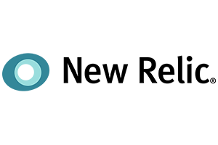






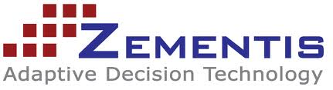









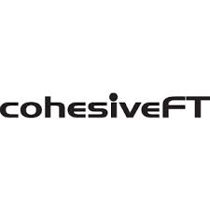
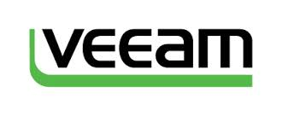











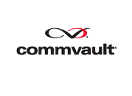




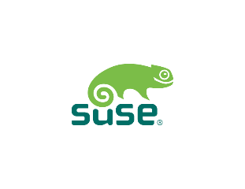










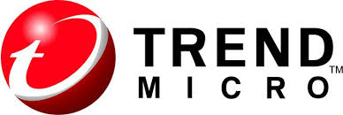


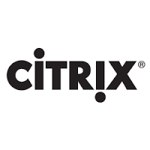



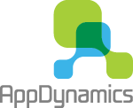












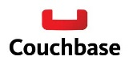


Leverage Azure Marketplace
Notes:
Lots and lots of great solutions provided by our partners
These can be either individual VM solutions or multi-VM

Slide 32
VM Scale Sets
High performance provisioning of 1000+ VMs
Auto-configuration at scale
Auto-scale based on schedule and resource metrics
Easy updates at scale
Simple Portal Integration
Notes:
So, VMs are great… but managing a lot of them individually can be hard. That’s where VM scale sets comes in..
The goal here is to enable management of like VMs as a group and make it easy to scale them in/out based on demand.

Slide 33
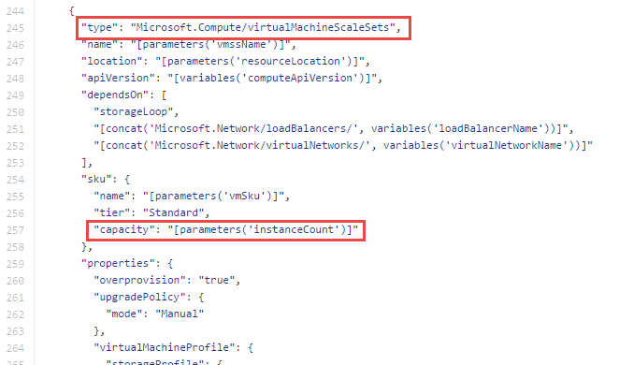
Why VM Scale Sets?
Manually scale with ‘capacity’ property
Autoscale with host metrics (MDM pipeline) or diagnostic extensions​
Small buy-in: Deploy/manage sets of 0->100 identically configured VMs ​
Guest OS patching: Patching primitives allow manually triggered rolling upgrades​​
High-availability – implicit availability set with 5 FDs/5 UDs​
Availability Sets vs Scale Sets
Avail Set: Multiple different VMs (image, size, etc); managed separately
Scale Set: Large count of the same VMs; managed together
Scale set: Reliable rapid provisioning and scale utilizing similarity of the VMs

Slide 34




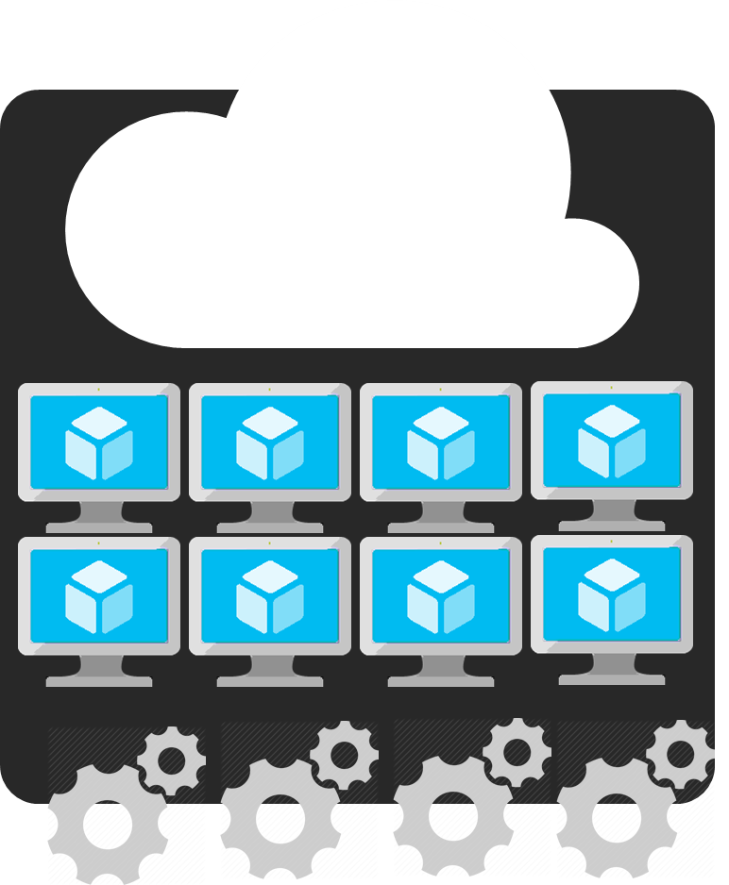
Azure Batch
APIM
Mobile apps
Logic apps
API apps
Notification hubs
Azure
functions
Compute pools for job processing
Automatic scaling and regional coverage
Linux and Windows
Automatically recover failed tasks
Input/Output handling
Low-Pri (discounted) option
Notes:
So with that little bit of context on VM scale sets, let’s start slowly moving up the stack…
While you can use VMSS directly, we expect most customers will interact with them through a higher-level abstraction.
One of those is Azure Batch, which enables highly-parallelizable job processing. You provide it with your job, configure the amount of compute you want to throw at it, and Batch will both schedule it efficiently and restart failed tasks as required.
Common scenarios include financial risk modeling, climate analysis, and media encoding

Slide 35
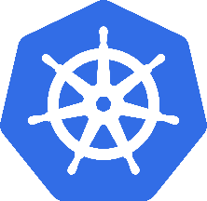
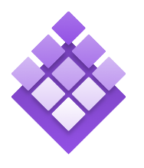

Azure Container Service
Azure Container Service
Standard Docker tooling and API support
Streamlined provisioning of DCOS and Docker Swarm
Linux and Windows Server containers
Azure and Azure Stack
Kubernetes
DC/OS
Swarm
Notes:
Running alongside excitement in containers has been excitement about container orchestrators.
The core job of the orchestrator is to take your containers and deploy them within a pool of compute infrastructure, then monitor their health and resource usage as they run, restarting or load balancing them as required.
Two popular OSS orchestrators are DC/OS and Swarm. DC/OS is developed by Mesosphere and is based on the Apache Mesos scheduler, whereas Swarm is built by Docker Inc.
So what is the role of ACS relative to the orchestrators? Well, historically they’ve been a pretty big pain to set up since each has a set of specific dependencies and expects a particular topology, including the deployment of a master node alongside a set of workers. ACS provides an easy way to configure an Azure environment that covers all of that and creates an environment that incorporates a number of best practices.
One important thing to note here is that EVERYTHING is OSS. You could easily take apps running on ACS and move them to another environment without changing anything you do.

Slide 36

Azure Container Instances
Simplest and easiest way to run individual containers in the cloud
No VM management
Per-second billing with customized resource requests
Linux and Windows Server containers
Notes:
Running alongside excitement in containers has been excitement about container orchestrators.
The core job of the orchestrator is to take your containers and deploy them within a pool of compute infrastructure, then monitor their health and resource usage as they run, restarting or load balancing them as required.
Two popular OSS orchestrators are DC/OS and Swarm. DC/OS is developed by Mesosphere and is based on the Apache Mesos scheduler, whereas Swarm is built by Docker Inc.
So what is the role of ACS relative to the orchestrators? Well, historically they’ve been a pretty big pain to set up since each has a set of specific dependencies and expects a particular topology, including the deployment of a master node alongside a set of workers. ACS provides an easy way to configure an Azure environment that covers all of that and creates an environment that incorporates a number of best practices.
One important thing to note here is that EVERYTHING is OSS. You could easily take apps running on ACS and move them to another environment without changing anything you do.

Slide 37
Azure App Service
Enterprise-grade apps
Fully managed platform
High productivity development
Global data center footprint
Hybrid support
Built-in auto scale and load balancing
High availability with auto-patching
.NET, Java, PHP, Node, and Python
Staging and deployment
AAD integrated
Secure + compliant
Reduced operations costs
Backup and recovery
Source code control integration
App gallery marketplace

Slide 38

Microsoft Global Network
Greenland
Svalbard
United States
Sweden
Norway
Russia
Canada
United Kingdom
Poland
Ukraine
Kazakistan
Russia
France
One of the largest private
networks in the world
8,000+ ISP sessions
130+ edge sites
44 ExpressRoute locations
33,000 miles of lit fiber
SDN Managed (SWAN, OLS)
United States
Turkey
Algeria
Iran
China
Pacific Ocean
Mexico
Atlanta Ocean
Libya
Egypt
Saudi Arabia
India
Myanmar (Burma)
Mali
Niger
Chad
Sudan
Pacific Ocean
Nigeria
Ethiopia
Venezuela
Colombia
Dr Congo
Indonesia
Peru
Brazil
Angola
Zambia
Indian Ocean
Bolivia
Nambia
South Africa
Australia
Owned Capacity
Data center
Argentina
Leased Capacity
Moving to Owned
Edge Site
DCs and Network sites not exhaustive

Slide 39







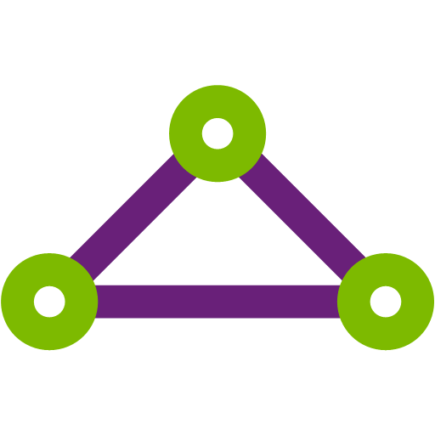

Robust networking infrastructure services
Virtual Network
Provision private networks, optionally connect to on premise datacenters. NSG, User Defined Routes, & IP addresses.
Load Balancer
Deliver high availability and network performance to your applications
Application Gateway/WAF
Build scalable and highly-available web front ends in Azure
DDoS Protection
Protect your Azure resources from DDoS attacks
VPN Gateway
Establish secure, cross-premise connectivity
Azure DNS
Host your DNS domain in Azure
Content Delivery Network
Ensure secure, reliable content delivery with broad global reach
Traffic Manager
Route incoming traffic for high performance and availability
ExpressRoute
Dedicated private network fiber connections to Azure
Network Watcher
Network performance monitoring and diagnostics solution
Notes:
These are all the component pieces of Azure’s networking infrastructure

Slide 40
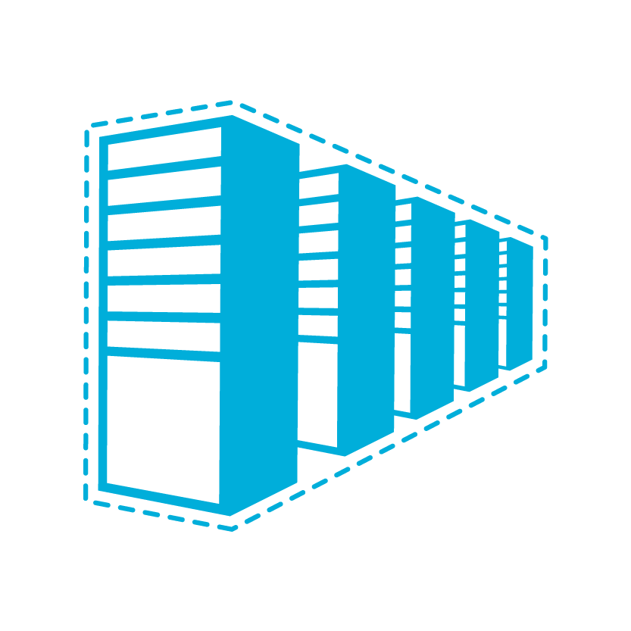


Connectivity to Azure
Cloud
Customer
Characteristics
Internet facing with public IP addresses in Azure
DNS, load balancing, DDoS protection, WAF
Internet Connectivity
Remote Access to VNet/On-prem
Connect from anywhere
Mac, Linux, Windows
Radius/AD authentication
Remote access point-to-site connectivity
High throughput, secure cross-premises connectivity
BGP, active-active for high availability & transit routing
Site-to-site
VPN connectivity
Private connectivity to Microsoft services (O365, Azure PaaS services)
Mission critical workloads
ExpressRoute private connectivity

Slide 41
Connectivity within Azure
Cloud
Cloud
Characteristics
Same-/cross-region direct, private VM-to-VM connectivity
NSG & UDR across VNets
GatewayTransit for hub-and-spoke
VNet Peering
Transitive routing via BGP and VPN gateways
Secure connectivity via IPsec/IKE across Azure WAN links
VNet-to-VNet via Gateways

Slide 42
Azure Storage Services
IaaS
PaaS
Virtual machines
Existing frameworks
Web and mobile
Microservices
Serverless Compute
Storage
Networking
Disks
Persistent disks for Azure IaaS VMs
Premium Storage Disks option: SSD based, high IOPS, low latency
Files
Fully Managed File Shares in the Cloud
SMB and REST access
“Lift and shift” legacy apps
Blobs
Highly scalable, REST based cloud object store
Block Blobs: Sequential file I/O
Cool Tier Available
Page Blobs: Random-write pattern data
Append Blobs
Tables
Massive auto-scaling NoSQL store
Dynamic scaling based on load
Scale to PBs of table data
Fast key/value lookups
Queues
Reliable queues at scale for cloud services
Decouple and scale components
Message visibility timeout and update message to protect against unreliable dequeuers
Built on a unified Distributed Storage System
Durability, Encryption at Rest, Strongly Consistent Replication, Fault Tolerance, Auto Load-Balancing
Notes:
AZURE STORAGE SERVICES
We can break them out broadly into the 2 deployment models, IaaS where you’re running your own infrastructure or PaaS where you are using higher level services and applications which are developed against the public cloud infrastructure.
On the Infrastructure side (IaaS) we provide DISKS and FILES, Disks are single instance Disks which are attached to VMs. There are two flavors, Standard and Premium. And Files are shared storage over SMB. Both of these are provided as services to your VMs.
For PaaS we have three core objects which are Objects, Tables and Queues.
Our unstructured Object Store (or Blob Storage) offers Exabyte scale and the ability to store trillions of objects across different tiers. Our current tiers are Hot storage for higher performance and frequently accessed data and Cool storage for less active & archived data.
Tables is our massively scalable NoSQL key-value store for structured and semi-structured data.
Queues service for reliable intra and inter-service communications, great for decoupling your work flows.
All of these services are built on the common unified distributed storage system. So all of the capabilities we talked about previously are available to all of these services.

Slide 43

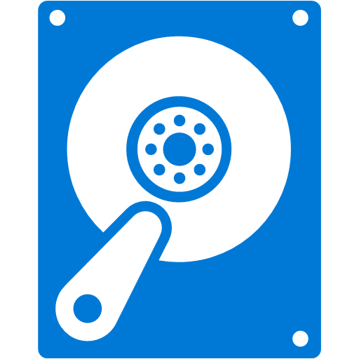


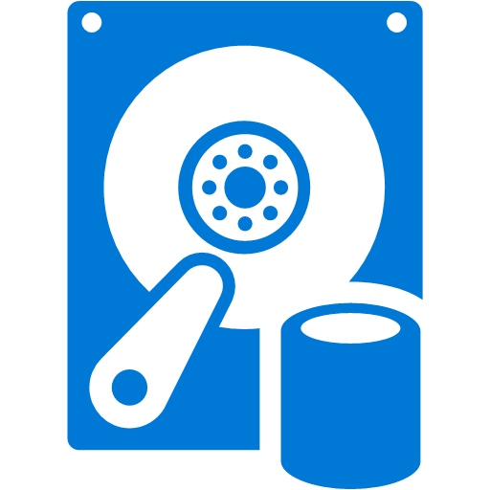
What are Managed Disks?
Managed by Azure
Simple - Abstracts storage accounts from customers
Granular access control – Top level ARM resource, apply Azure RBAC
Better performance - Storage account limits do not apply
Big scale - Up to 10,000 disks per region per subscription
OS disk
PAGE BLOBS
Data disk
Managed Storage accounts

Slide 44
Disks - Best Practices
Always* use Premium Disks for Production workloads
Managed Disks only for new workloads
Upgrade legacy unmanaged to managed when possible
RAID for redundancy is not necessary
RAID for performance as needed
Durability doesn’t remove the need for backups
Performance
Local ssd is definitely temporary, use if you can tolerate loss
Enable read caching where appropriate for better perf
Understand VM limits vs Disk limits for perf

Slide 45
Azure Database Services

Slide 46


Why Azure SQL Managed Instance?
Are your customers interested in moving to cloud?
Want to close your data center
Current hosting solution is high maintenance
You’re asked to do more with less
Want to expand your reach globally
Managed Instance brings PaaS closer to you!
???
Do your customer want to avoid app rewrites but still benefit from PaaS?
Notes:
Are you interested in moving to cloud?
Want to close your data center
Current hosting solution is high maintenance
You’re asked to do more with less
Want to expand your reach globally

Slide 47
What is SQL Database Managed Instance?
DBaaS designed to for all SQL Server applications
SQL Database (PaaS)
Singleton
Elastic Pool
Managed Instance
Unmatched app compatibility
Unmatched PaaS capabilities
Favorable business model
Fully-fledged SQL instance with nearly 100% compat with on-prem
Lowest TCO + rich Azure ecosystem
Built-in automatic management
Compliance certifications
Competitive
Transparent
Core and storage
Frictionless

Slide 48
Managed Instance: Unmatched PaaS capabilities
On-demand resources & elasticity
No need to provision for that monthly / yearly peak
Built-in high availability
99.99% SLA with automatic failover
Business continuity
Automatic backups, point-in-time restore, long term retention
Backups kept in geo-redundant storage
Active geo-replication (<5 sec RPO)
Automatic patching / version updates
The service guarantees availability and no regression in experience
Built-in intelligence
Threat Detection
Automatic performance tuning & Intelligent Insights

Slide 49
How to choose between PaaS and IaaS?
If you:
Need control over / access to the operating system
Have to run your app or agents side-by-side with the database
Want to continue to manage all aspects of your solution
…then IaaS is the right solution for you
Otherwise, we recommend PaaS
Much better total cost of ownership
You can focus on your business, and innovate

Slide 50
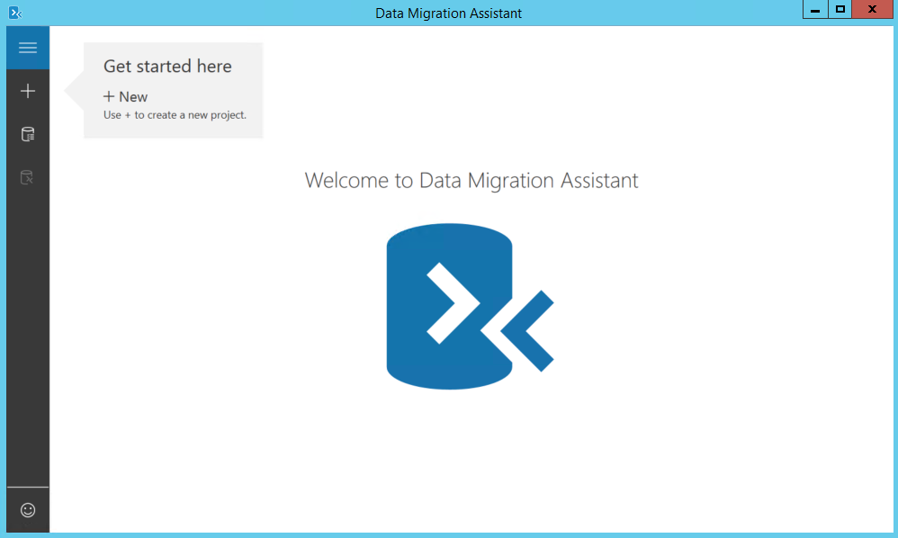
Some apps don’t need Managed Instance
You can migrate some apps w/o any changes, today
Starting migration now by
Downloading and running Data Migration Assistant
Automated assessment will identify databases that are safe to move, w/o changes

Slide 51
Managed Instance: destination for even the most demanding applications
Offers full security & isolation
VNET enables full isolation, without public IP addresses
VPN can make it part of your enterprise network
Decreases cost and risk of migration
Instance design increases compatibility with on-premise SQL Server
Database Migration Service further simplifies and automates migration
Offers new business model and pricing
Ability to use on-premise SQL licenses

Slide 52
Full security & isolation
VNet1
VNet-to-VNet
Web app
(public IP)
SQL Instance #1
SQL Instance #2
Network isolation (customer VNET)
SQL Instance #3
Tenant isolation
(compute, storage)
“Virtual data cluster” dedicated to customer
(virtual private cluster, VNET, private IPs)
VPN / Express Route Gateway
IPsec IKE S2S VPN Tunnel
оn-premises

Slide 53
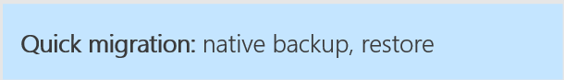
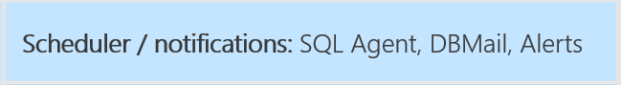
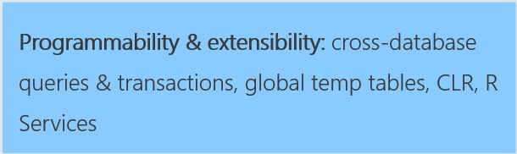
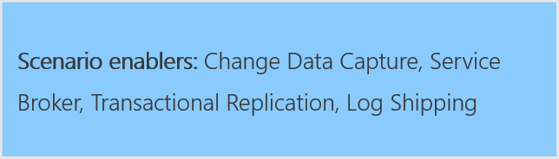
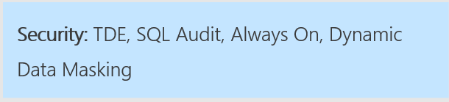
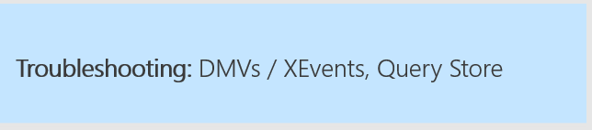
Nearly 100% compatibility with SQL server
Support is coming in stages until General Availability of Managed Instance

Slide 54
Migration: Version compatibility
Most users would prefer the latest version
The major concern is risk associated to upgrades
We will support migrations from SQL 2005+
We will keep supporting old version DB compat levels in cloud
10% doesn’t care
9% must run the same version
81% would prefer the latest version

Slide 55
Azure Database Migration Service (DMS)
Reliable and seamless migrations
Fully managed database migration service for both operational databases and data warehouses
Supports minimal down time migrations
Supports both homogeneous and heterogeneous source-target pairs
Initial focus on reliability and performance
Iterative addition of source-target pairs
Continued investment in friction-free competitive conversions
SQL DB
Oracle
SQL
SQL
Note: For more information, contact datamigrationteam@microsoft.com.

Slide 56
Migration: SSIS / SSAS / SSRS
These services will not be installed side-by-side with Managed Instance
Recommendation: move to PaaS model
Migrate your SSIS packages to new SSIS PaaS service
Migrate your OLAP models to Azure Analysis Services
… or run these services in Azure virtual machines
For SSRS, the recommendation is to run in a virtual machine
Notes:
The PaaS model for these services has many advantages: provisioning on demand, scale-up and down, start/pause, etc. Also, it opens up opportunities with connecting to other Azure services easily, and enriching your data integration, BI or reporting workflows… opens up the way to modernization.
VMs are the fallback option… and for SSRS this is currently the only option. There is a licensing aspect here as well, as to run SSIS / SSAS or SSRS in a VM, you need a SQL Server license. In PaaS services, you pay exactly what you’re using, so you should have more cost control this way.

Slide 57
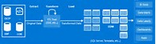
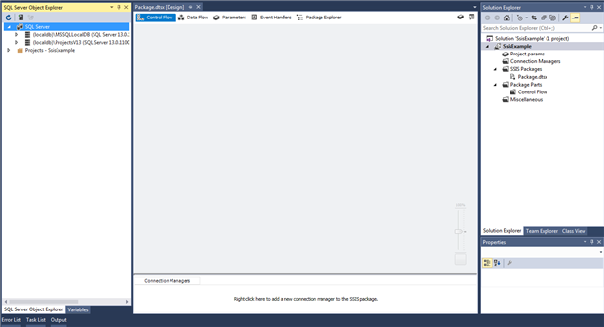
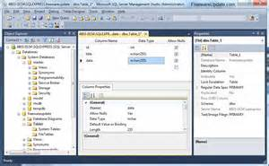
SSIS PaaS service (in preview)
Goal: execute your SSIS packages, without changes
How?
SSIS instance provisioned under Azure Data Factory
Catalog (SSISDB) can be stored on Managed Instance
Authoring / deployment by SSDT
Execution / management by SSMS and SQL Agent
Provisioned on-demand, tunable scale
ADF (ENTRY POINT, ORCHESTRATION, DESIGN)
Provision
SSIS PaaS on ADF compute resource
Execute/ Manage
Author/
Deploy
Cloud
On-Premises
Author/Deploy
Execute/Manage
SSDT (ENTRY POINT)
SSMS (ENTRY POINT)
Author/Deploy
SSIS Server
Execute/Manage

Slide 58
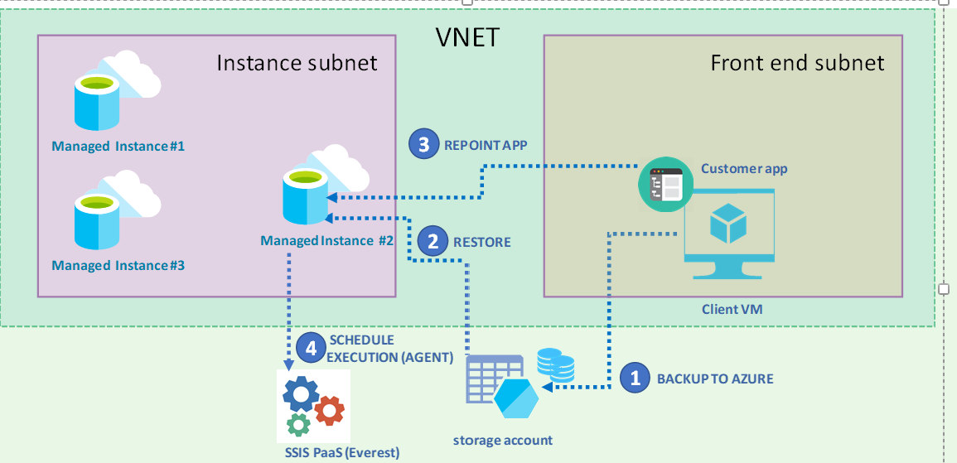
Demo: Migrate Easily to Managed Instance

Slide 59

DATA CDN for your Edge Geo-Replication to edges of your deployments
GA
Automatic failover policy
Replicas are automatically points to the new primary afterward
Replicas to fit your topology
Same region or different region
Available in all 38 Azure regions!
REST API, PowerShell or Azure Portal
Up to 4 secondaries

Slide 60
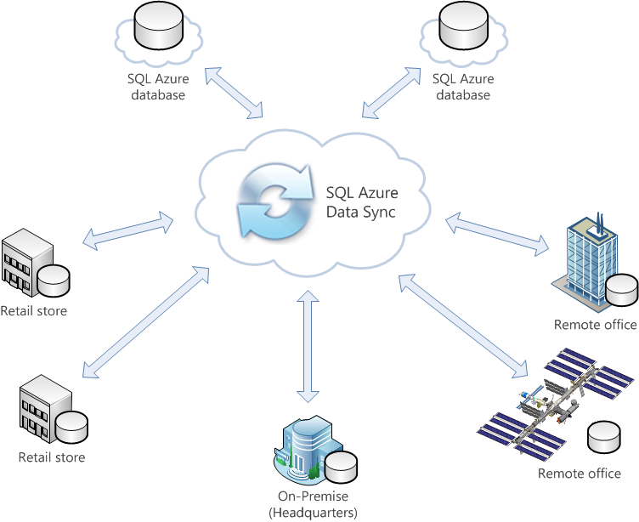
Keep data up-to-date across all SQL databases Distributed Applications
SQL Azure Data Sync (v2)
Public Preview
All SQL databases supported (SQL Server, SQL IaaS & Azure SQL Database)
Zero code required to enable data synchronization among SQL databases
Hub-and-Spoke Synchronization technology
Both One-way or Bi-directional synchronization
Table-level synchronization with Column Filter
Minute-level latency
Notes:
SQL Data Sync allows developers to easily synchronize reference data across multiple SQL Server, SQL VM, and Azure SQL databases. Increasing number of developers and ISVs are developing and running their geo-distributed SaaS and hybrid applications on Azure and utilizing Azure SQL Database as the data-tier. For on-prem SQL Servers with intermittent connectivity to the cloud or for Azure applications that desire low latency, a copy of the reference data needs to be co-located with the application for optimal lookup and update speeds.
With the ability to sync one-way or bi-directionally, SQL Data Sync enables developers to set up scheduled synchronization without having to write any custom code or managing their own cloud infrastructure. Besides going through Microsoft Azure Portal, users can also use Powershell and REST APIs to get diagnostic logs and alerting.

Slide 61
Seamless cloud integration Easy lift-and-shift, integrate and distribute
Azure SQL Database Managed Instance
Managed SSIS in Azure
Azure SQL Database Managed Instance facilitates lift and shift migration from on-premises SQL Server to cloud
Azure Hybrid Benefit for SQL Server maximizes current on-premises license investments to facilitate migration
Database Migration Service (DMS) provides seamless and reliable migration at scale with minimal downtime
Active Geo-replicas “data CDN” for your edge deployments
SQL Azure Data Sync v2 synchronize data across distributed and occasionally connected applications
Azure Hybrid Benefit (AHB) for SQL Server
Database Migration Service (DMS)
SQL Server
Most consistent data platform

Slide 62

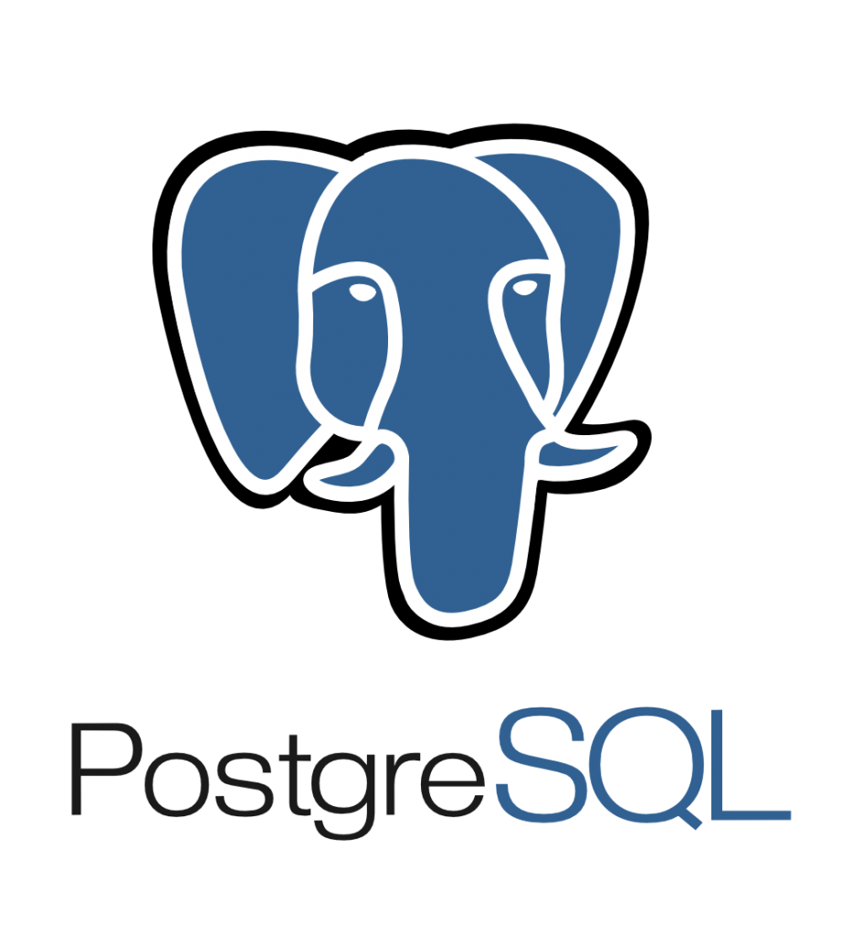
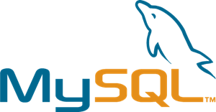
Managed community VERSION MySQL, PostgreSQL, and MariaDB
My
Focus on your apps by leaving the management and patching of your infrastructure and database to an enterprise-ready cloud service
Automatic updates
Automatic security fixes
Automatic new feature updates
Notes:
Managed community database engines
We are specifically not “forking” the OSS-versions of MySQL, PostgreSQL and MariaDB, but rather picking-up the community editions as they are. This means that customers should have no concerns about application compatibility when moving from either on-premises, IaaS or another cloud to Azure as their applications will work the same. Being a fully-managed service means developers can focus on writing great apps instead of tuning and patching the host OS and database engine. In addition, key requirements for a mission-critical database such as backups, HA and the ability to scale performance with little/no downtime are built-in and more importantly – at no additional cost! With Azure Database Services, you can be assured that Microsoft will keep your database service up to date and tuned for the best performance.

Slide 63
Migration technics

Slide 64
Migration approaches
Re-deploy
Backup the workload configuration, deploy new VM in Azure and restore the configuration
Backup and restore the database
Good for stateless workloads, clean installation using Azure Marketplace image
Consider containers as an option instead of VMs
Workload-level Scale-out
Configure on-prem to Azure connectivity using S2S VPN or Express Route
Deploy additional domain controllers in Azure
Deploy additional nodes of the workload in Azure (e.g. heavy web apps and worker nodes)
VM Lift & Shift
Azure Site Recovery (ASR) as a recommended and free solution for migration to Azure at scale
Deploy ASR agents on VMs, replicate to Azure, failover.
Database-level migration
Using technologies like SQL Server AlwaysOn Availability Groups
Azure Database Migration Service (DMS) for migrations to Azure SQL Database
Attunity Replication for Microsoft – free solution, extending the capabilities of DMS
Large data migrations
Azure File Sync or StorSimple Virtual Appliance to upload large amounts of data to Azure
Disk import and Azure Databox

Slide 65
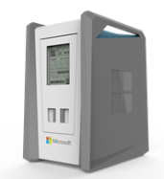
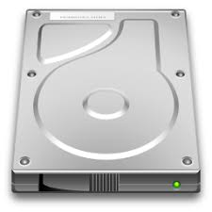
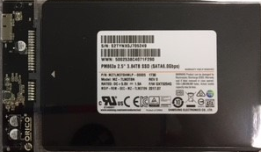
Uploading large amounts of data to Azure
Disk Import
Disk Rental
Data Box
StorSimple Virtual Appliance
Capacity: <10TB
Customer supplied disk
USB/SATA Interface
Ships in tamper resistant case
High capacity with Super Transport
Capacity: <10TB
Azure leased service
Tamper resistant
Low complexity - USB
Low cost
Capacity: 100TB
Human scale: < 50 lbs.
Ruggedized, tamper, water resistant
SMB Interface
Large Fleet Size
Automated Ordering and Managed Service in Azure
Capacity: <64TB
Deploy on Hyper-V or vShere host on-prem
Replicate data to Azure
Extract replicated data
Specifications
Currently Available
Preview Mid-year ‘18
Currently in Preview
Currently Available
Availability

Slide 66
Migration assessment
Purpose of migration assessment – build a detailed migration plan and present it to customers
Steps:
Deploy Cloudamize in the source environment on all servers with migration potential
Leave it for 2 weeks to collect data
Cloudamize detects OSs and SQL Server editions, analyzes usage trends to recommend RIs and checks if ASR can be used for lift&shift migration
Use DMA to assess detected SQL Server workloads
Detect non-SQL Server databases and select a migration approach manually
Build reports and prepare offers for each customer

Slide 67
VM assessment with Cloudamize
SaaS solution for cloud migration discovery & assessment
Supports VMWare 5.0+, Hyper-V 2008 R2+ and non-virtualized servers
VMs running on exotic hypervisors can be treated as non-virtualized servers
Hypervisor lever assessment for Vmware – no need to touch tenant VMs
Agent-based or agent-less deployment options.
Needs 14 days to collect data and build reports
To get Cloudamize licenses for free – send a request to dcmsupport@microsoft.com That’s $40/VM value, available to DCM partners free of charge.

Slide 68
Database assessment with DMA
Microsoft Database Migration Assistant (DMA) is a free tool to analyze SQL Server DB compatibility with SQL Server 2017 and Azure SQL Database
Can analyze if database can be moved to Azure SQB Database (PaaS or Managed Instance)

Slide 69
Building v2 of the migration plan
For each customer:
Calculate the cloud cost and compare it with current cost
Choose how to migrate VMs and databases
Present offer to customer

Slide 70
Execute the migration plan
Create Customer accounts in Partner Center
Create Azure subscriptions, vNets and establish site-to-site connectivity
Deploy ASR
Deploy DMS
Migrate workload by workload
Implement Azure Advisor recommendations to optimize workloads for Azure

Slide 71
Best Practices
Cost is not the only deciding factor for customers. SLA, certifications, development strategy, rich service portfolio can be more important for long-term considerations.
Try to unveil hidden opportunities during the assessment. Include more VMs to the discovery scope using free Cloudamize licenses benefit.
Every customer runs databases. That’s a huge revenue opportunity for CSP partners, especially for SQL Server. Don’t miss it.
Migration with downtime is a good option if possible. Re-deploy usually requires less efforts and fresh environment is usually more stable (don’t bear existing configuration issues and garbage from on-prem)
Uptime of the workload is different from VM uptime. Customers may not even notice that VM was disabled during the migration if workload remains accessible.
Azure Traffic Manager can help with IP address changes during the migration.

Slide 72
Next Steps
Review aka.ms/dcmkit
Reach us at dcmsupport@microsoft.com

